Slide 1
Create Token Gate Merchant Experience
Eventbrite

Slide 2
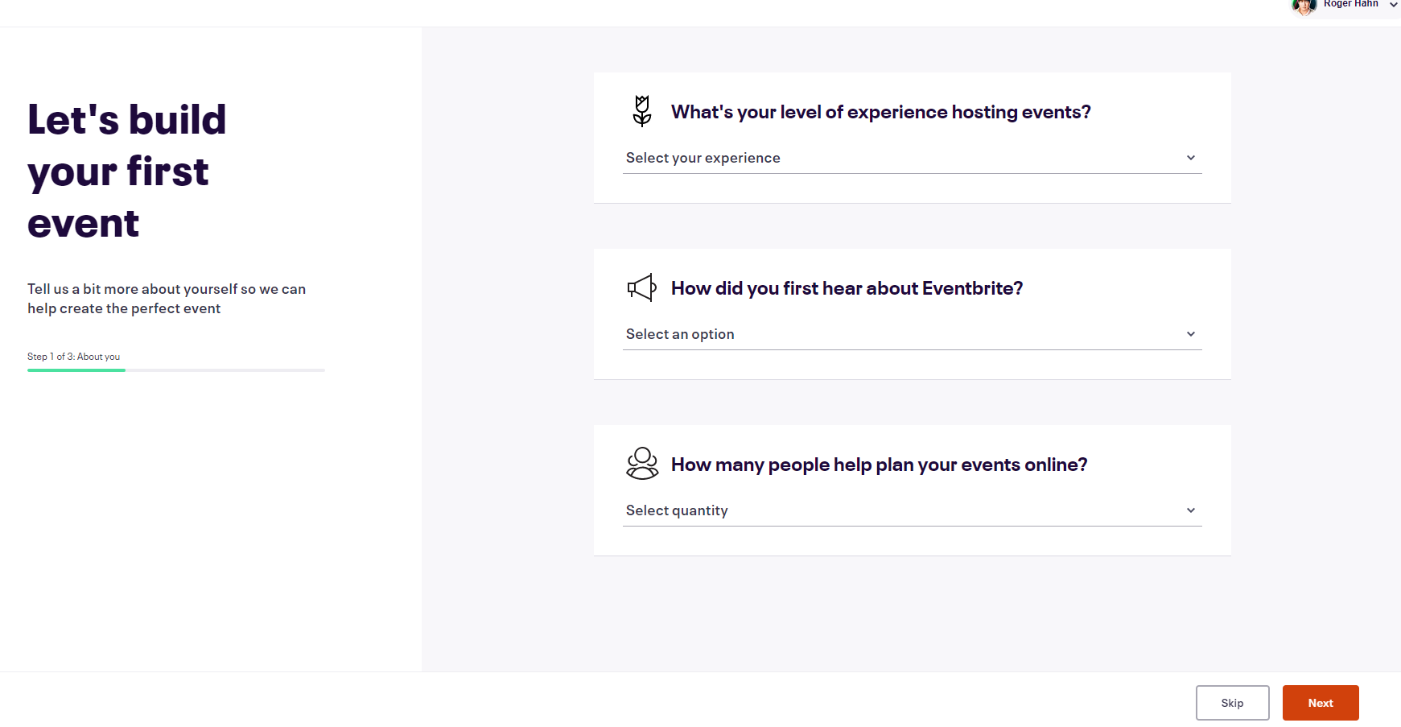

Slide 6
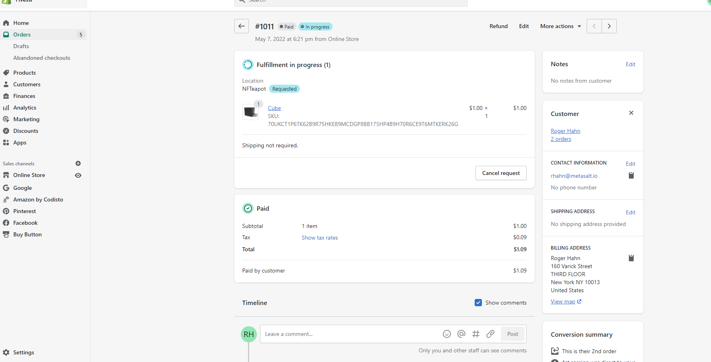
Back to Admin Orders page

Slide 7
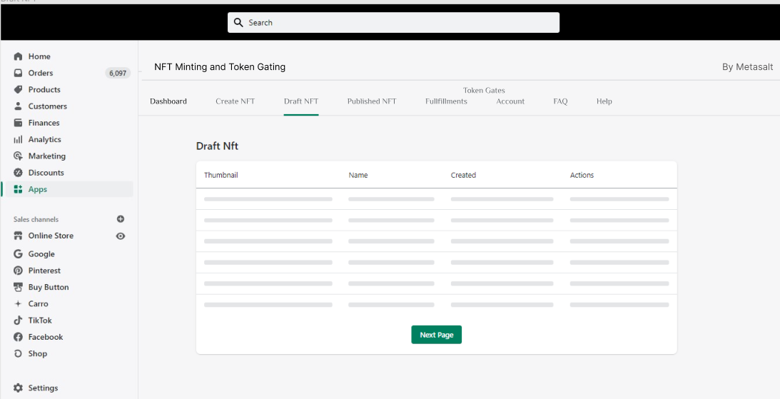
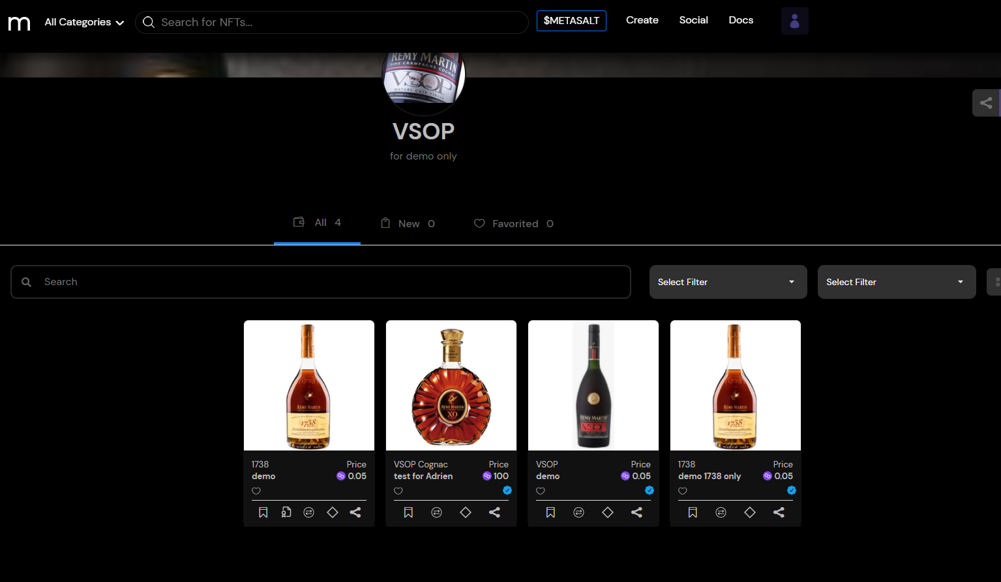
Add a Token Gate

